Slide 1
Speech Translation Project
By Rishabh Chaurasia

Slide 2
Contents
Problem statement
Existing system
Concepts to be used
Training datasets
Evaluation metrics
Input and output
Few related works and their references.

Slide 3
Problem Statement
An average person speaks 11000–25000 words per day making speech the most common way of expressing ourselves. Be it a conversation, dialogue, speech, presentations or any general talks, we use speech to make other as well as ourselves understand thoughts and actions. If either of the side is unaware of the language of communication, the cycle will be incomplete. Hence we need a system that can bridge this language barrier. Speech to speech translation is one such system that can play important role by facilitating communication between persons speaking different languages. Worldwide efforts are being made to achieve this goal and implement it practically for use by common man.

Slide 4
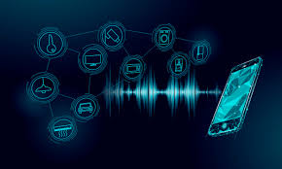
The Existing & Proposed System
Google translate, Skype translator , Jibbigo, Moses

Slide 5
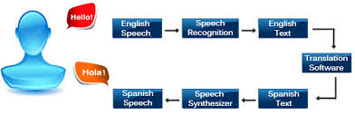
Limitations of Existing Softwares
Current state-of-the-art translation systems for speech-to-speech rely heavily on a text representation for the translation. By transcoding speech to text we lose important information about the characteristics of the voice such as the emotion, pitch and accent. This project is using an LSTM neural network model to translate speech-to-speech without the need of a text representation. That is by translating using the raw audio data directly in order to persevere the characteristics of the voice that otherwise get lost in the text transcoding part of the translation process.

Slide 6
Concepts we must use
Sequence to sequence learning, Neural networks , Backpropagation , Deep Learning , Recurrent neural networks , Long short-term memory neural networks, Regularisation ,Short-time Fourier transform.

Slide 7
Training Datasets
Mozilla Common Voice Dataset
Movie Subtitles Dataset
https://analyticsindiamag.com/top-nlp-libraries-datasets-for-indian-languages/
http://www.cfilt.iitb.ac.in/iitb_parallel/
http://lotus.kuee.kyoto-u.ac.jp/WAT/indic-multilingual/index.html
https://lionbridge.ai/datasets/12-best-hindi-language-datasets-for-machine-learning/
https://ai.baidu.com/broad/download

Slide 8
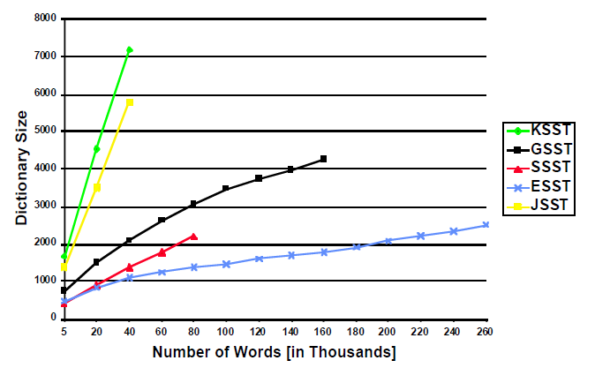

Slide 9
Evaluation Metrics
The metrics we intend to test our model with are:
BLEU score (Papineni et al., 2002),
NIST score and
Latency (since we want to make it real-time).
The search for the best weight setting is a line search for each λm, which is repeated until no improvement can be achieved.

Slide 10
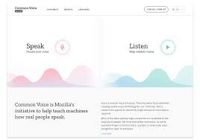
Input & Output of the Model
Input
Audio clip of speech in foreign language (HINDI)
Output
Transcribe in the foreign language and the translated text in English

Slide 11
References
https://gupea.ub.gu.se/bitstream/2077/51978/1/gupea_2077_51978_1.pdf
https://link.springer.com/article/10.1007/s40012-013-0014-4

